Slide 1
Capstone Design
Team 3
20163704
20161344
20164245
Park JuHyeon
Heo JeongWoo
Hong Jin

Slide 2
Contents
1.
Feedback
Model
schedule
Q&A
2.
3.
4.

Slide 3
1.
Q&A Feedback

Slide 4
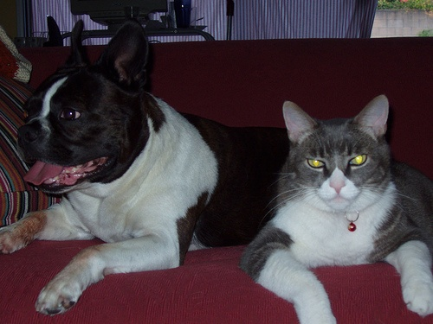
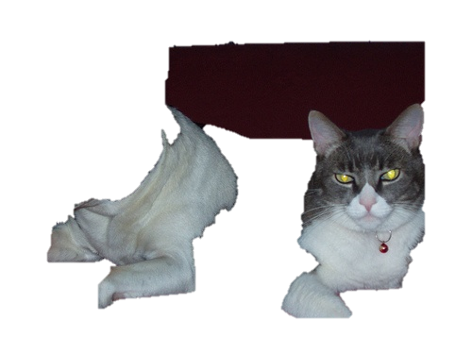
1
Q&A Feedback
PowerPoint Function
MS PowerPoint offers ‘background remove’ function
Original Image
After applying background remove

Slide 5
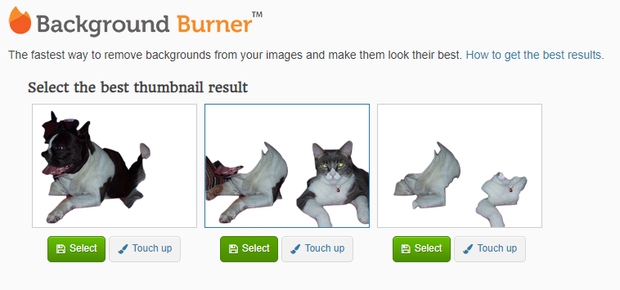
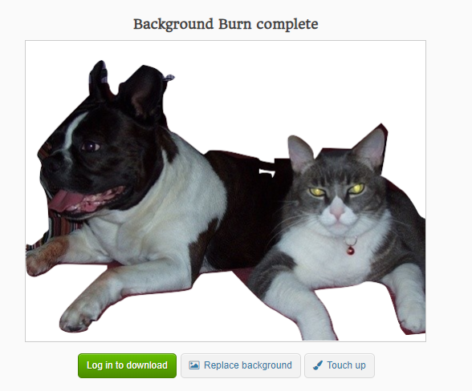
1
Q&A Feedback
Background Burner
Automatic removal
Manual removal

Slide 6
2.
Deep Learning Model

Slide 7
2
Model
DEXTR
Deep Extreme Cut
The paper that proposed the basic function of our program
Base Architecture
DeepLab-v2(CNN ResNet-101) + PSPNet

Slide 8

2
Model
DEXTR
Demo
Original Image
DEXTR demo result image

Slide 9
2
Model
Improve propose
1. DeepLab-v3+
2. ASPP or PSP
3. Find more & Feasibility check

Slide 10
3.
Schedule

Slide 11
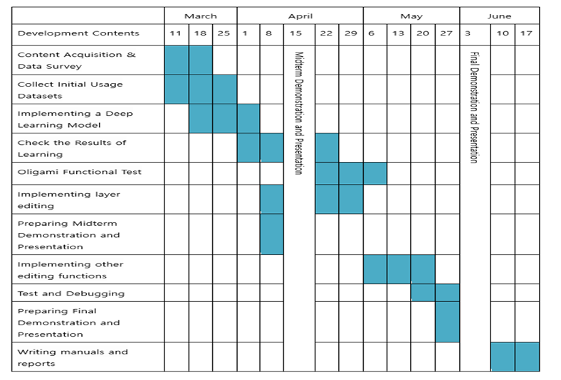
3
Total Schedule

Slide 12
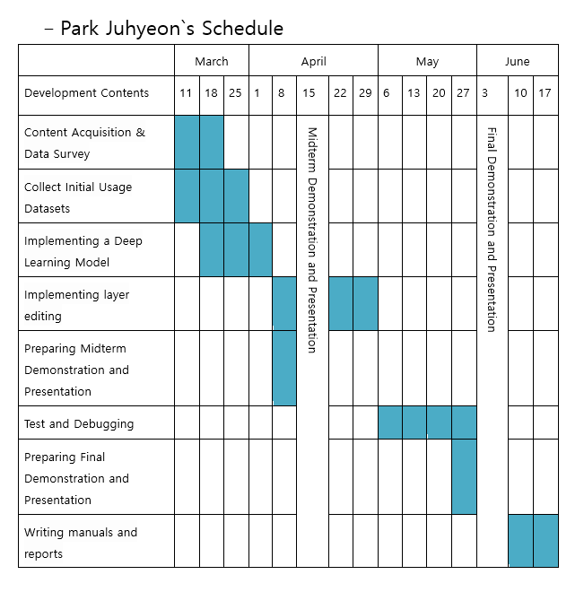
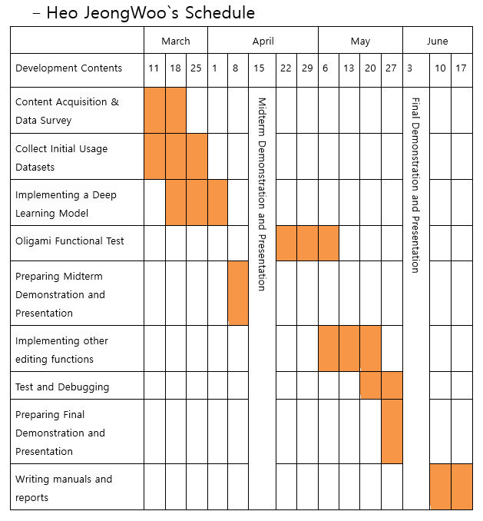
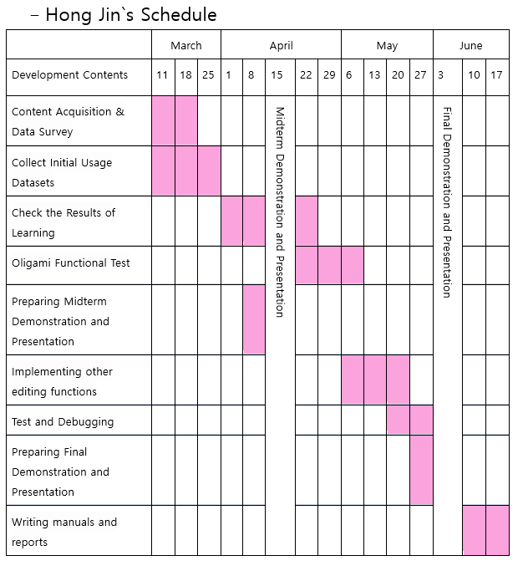
3
Schedule

Slide 13
4.
Q&A

